Slide 1
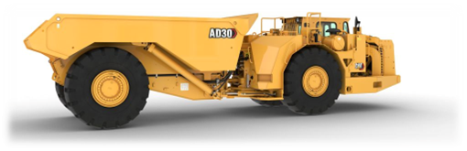
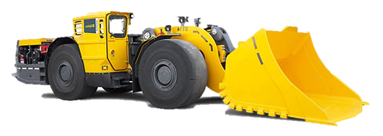
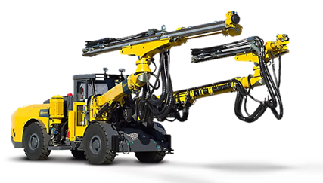
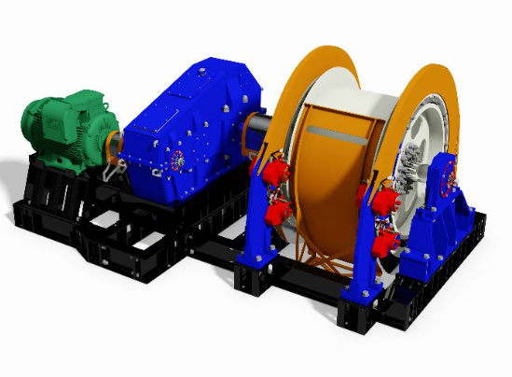

Weekly Engineering Report
Week 32
30 January - 05 February 2026

Slide 2
INDEX
1
Departmental Overview (HEAL)
2
Shafts & Winders Performance
3
Gloria Performance Overview
4
Nchwaning 2 Performance Overview
5
Nchwaning 3 Performance Overview
6
BEV Performance Overview

Slide 3
DEPARTMENTAL OVERVIEW (HEAL)
Highlights
Lowlights
[Gloria] CV055 chute repairs and hot splice done successfully.
[Gloria] Conveyor Watch completed scanning all steel cord belts.
[Gloria] TMM availability improved to 89%.
[N2] Improved HDs availability for the week.
[N3] Good scaler availabilities. Plant upgrade: 55CV01 motor to 45kW enabling 650 tph.
[Gloria] Diverter chute stuck between HG and LG silos.
[Gloria] CV0051 - 50mm conveyor damaged from side, rolled around tail pulley.
[Gloria] DTs availability 75% - Waiting Barloworld to assist.
[N2] Still charging two UVs; UV108 repairs in progress, completion moved to 11 Feb.
[N2] DT121 still standing with no clear indication of when OEM will assist.
[N3] Poor HD/RT availability due to CAS L9 issues.
Emerging Issues
Priorities
[Gloria] Stores stock level raising concern - most spares not available but shows stock on system.
[N2] Repetitive breakdown on HD53 on a prop shaft.
[N2] Service at drill shop not effective due to consumables shortage.
[Gloria] 74N tip liners to be repaired.
[Gloria] Conveyor Watch to submit splice condition report.
[Gloria] Commission surface compressor.
[N2] Drive actions on Engineers action tracker.
[N2] Changes on program for UV108 to be done next week.
[N3] DT0172 to be commissioned in place of DT0171.

Slide 4
Shafts & Winders Performance
Weekly Tons/Hr
Target: 523
674
Weekly RW Availability (%)
Target: 95%
98.3%
Highlights
Lowlights
Steady water supply from Vaal Gamagarra Water Supply.
Positions to be filled taking considerable time: 1x WTFitter @ Head-Hunting Stage.
Plumber Contractor not on site due to PP360 related issues.
Power outage experienced during the week.
Emerging Issues
Priorities
Low compliment of Fitters and Riggers in Mechanical Section putting pressure on the Section.
Massive impact of providing full maintenance of Changehouses of all 3 Shafts.
Additional low compliment due to WTF RFA related issue.
Shaft Repair Work with Solrock Team.
Employee Engagement/IDP sessions with SGM.
Shaft Exam with Machinery Inspector.
Shaft Dewatering Pump Test (revised to Feb 2026).
DMPR Instruction on Shafts & Winders.
Prep for Opportunity Maintenance during power outage to repair Cap-Banks.

Slide 5
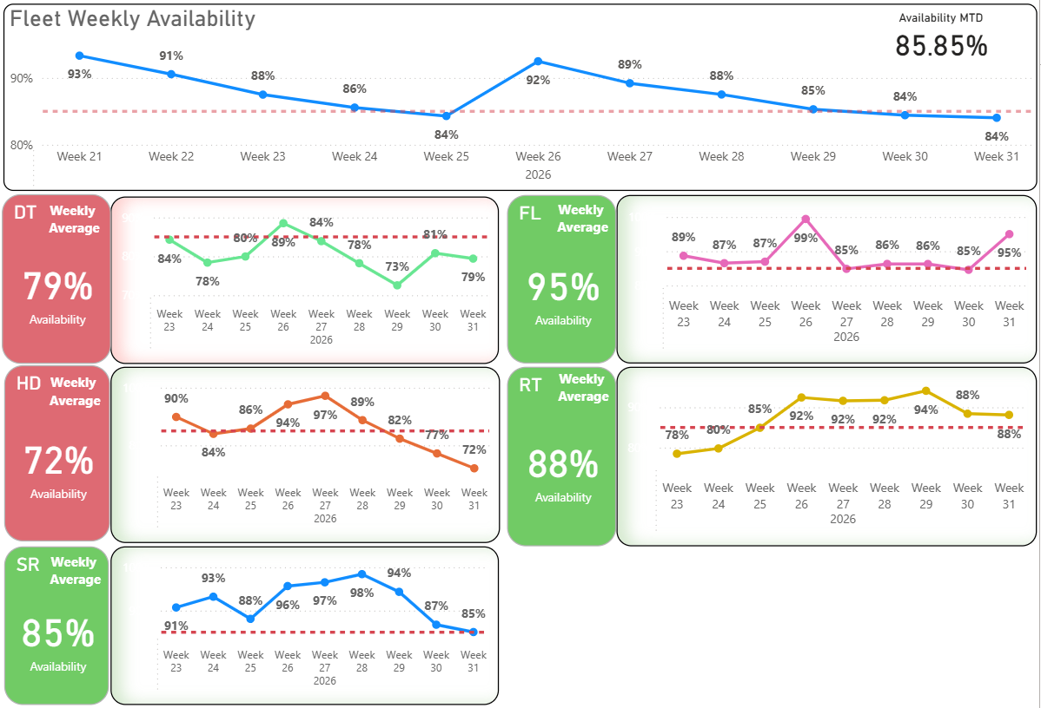
Nchwaning 3 Weekly Availability Trend

Slide 6
Nchwaning 3 Performance Overview
Safety
Weekly Avg.
Compliance
79.8% (Target: 85%)
FL 40% (2/5 planned). RT 60% (3/5). All other fleets 100%.
Equipment Availability
DT-Diesel
FL-Diesel
HD
RT
SR
81%
55%
78.8%
80.8%
93%
Key Breakdowns / Issues
FL-Diesel
HD
FL-Diesel 55% - FL101 steering problem. FL91 Strata/no modular contact. FL103 not starting.
HD 78.8% - HD49 airco motor leak. HD52 boom guards active. HD62 booms not drilling. HD51 no diesel.
Week 32: Overall 79.8% below target. DT-D 81%. FL-D 55%. HD 78.8%. RT 80.8%. SR 93%.
DT-Diesel
RT
DT-Diesel 81% - DT148 aircon/mainswitch. DT131 gears/strata. DT119 gears.
RT 80.8% - RT49 turning device. RT55 damaged. RT58 drifter oil leak. RT51 sprocket.

Slide 7
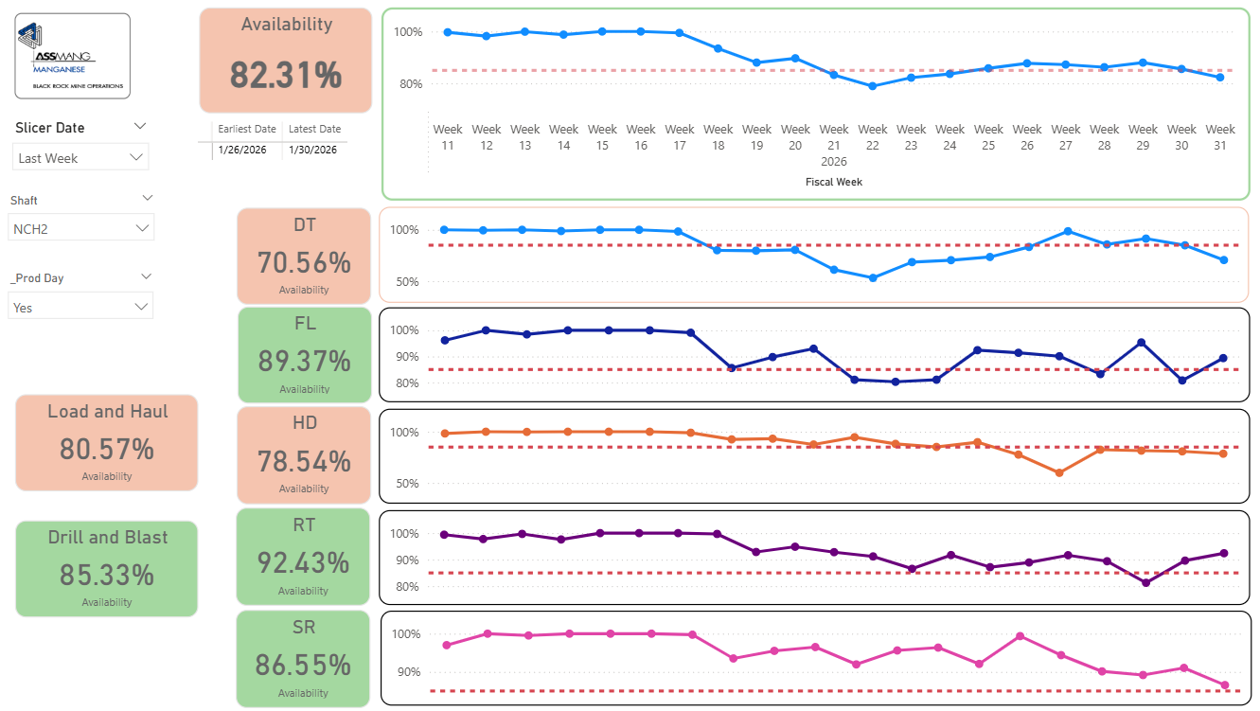
Nchwaning 2 Weekly Availability Trend

Slide 8
Nchwaning 2 Performance Overview
Safety
Weekly Avg.
Compliance
82.31% (Target: 85%)
Week 32 compliance data pending.
Equipment Availability
DT
FL
HD
RT
SR
70.56%
89.37%
78.54%
92.43%
86.55%
Key Breakdowns / Issues
DT
HD
DT121 still standing - OEM (Barloworld) assistance not confirmed.
HD53 - Repetitive prop shaft breakdown.
Week 32: Data pending - chart shows Week 31 snapshot. Overall 82.31%. DT 70.56%. FL 89.37%. HD 78.54%. RT 92.43%. SR 86.55%.

Slide 9
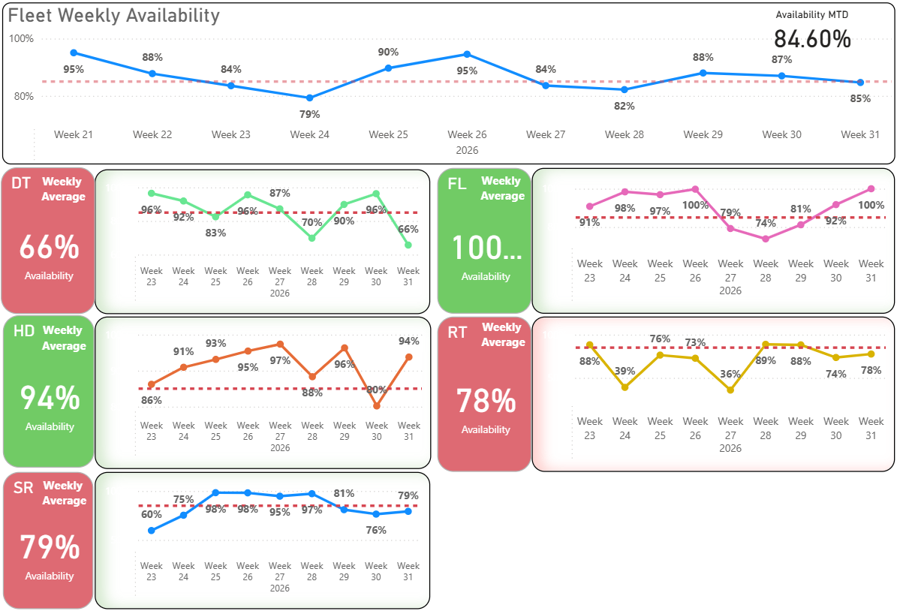
Gloria Weekly Availability Trend

Slide 10
Gloria Performance Overview
Safety
Weekly Avg.
Compliance
88.5% (Target: 85%)
DT 50% (DT0105 deferred). FL 100%. HD 100%. RT 100%. Support 100%. Overall 90%.
Equipment Availability
DT
FL
HD
RT
SR
75%
97.4%
93%
90.4%
86.8%
Key Breakdowns / Issues
DT
DT0174 - Not selecting gears (persistent).
DT0105 - Nerospec.
Week 32: Overall 88.5% above target. DT 75%. FL 97.4%. HD 93%. RT 90.4%. SR 86.8%.

Slide 11
BEV Fleet
BEV Availability (Wk 32)
BEV Service Compliance
DT BEV: 78% (Target: 85%)
FL BEV: 98% (Target: 85%)
DT BEV: None scheduled
FL BEV: None scheduled
BEV Availability by Equipment Type
DT BEV
Target: 85%
78%
FL BEV
Target: 85%
98%
Key BEV & Battery Themes
Key Breakdowns:
Key Battery Themes:
DT BEV
Battery: 10 ST14-B4 packs (1.6 ratio), 12 MT42-B5 packs. Charger stops investigated.
Critical: Aux motor spline grease campaign (only DT147 done). Post 7 CCS cables pending.
CAS L9: Lab scale tests with new software. MH4.0 to be loaded on BEV machines.
3 batteries down: VPY-00088 safe state (14d), VPX-00017 (12d), VPX-00028 pumps (4d).
DT0171 A-frame failure (16.3% avail) - 60-day lead time, expediting to fly in.
DT0149 gearbox failure + electrical faults (76.3% avail). DT0162 STRATA breakdowns (72.3% avail).
DT0150 Strata + electrical (94.2% avail). DT0146 isolation fault on HVIL cables (Tue).
FL BEV
FL BEV fleet performing well with 98% average availability.
FL0112 HVIL fault (Sun, 23.5 hrs - resolved). FL0098 boilermaker half arrows (Mon).

